Slide 1
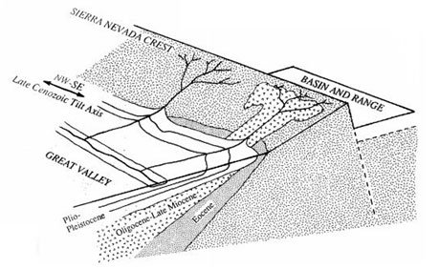
Stream Incision, Tectonics, Uplift, and Evolution of Topography of the Sierra Nevada, California
J. Wakabayashi & T. L. Sawyer, 2001
Presented by Yair Franco
GEOL 730, Fall 2024
(Bedwell, 2015)

Slide 2
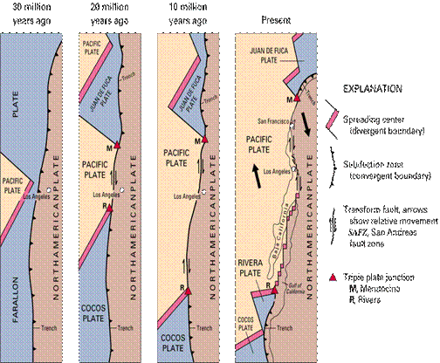
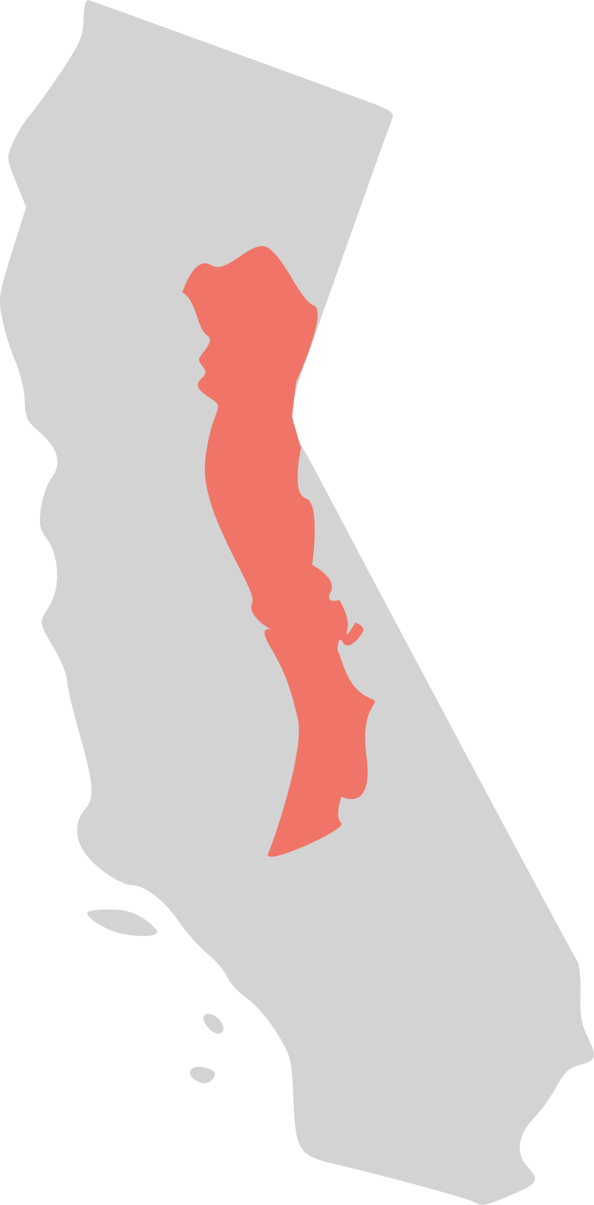
Background
(USGS)
Sierra Nevada formed by arc magmatism ending ~85 Ma
Additional volcanic activity in the Cenozoic (~35 to 5 Ma)
Activity dwindles along arc as Mendocino Triple Junction migrates northward
Volcanic deposits from Eocene and Cenozoic provide time constraints and geological info

Slide 3
Motivation
(Bedwell, 2015)
Consolidate past research on Sierra geomorphology and chronology
Analyze how geomorphology can reveal the history of how this region was formed
Demonstrate the complexity of mountain range formation and tectonic events responsible

Slide 4
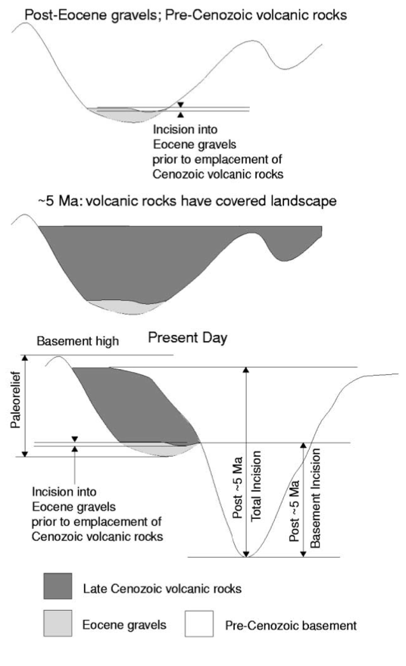
Methods & Data
Extensive previous research on Cenozoic (Mehrten formation) volcanic stratigraphy and aging
Eocene volcanic gravels provide a time constraint
Stream incision stratigraphy
Eocene gravel incisions vs. Cenozoic volcanic incisions
Deducted incision rates based on time constraints and depth

Slide 5
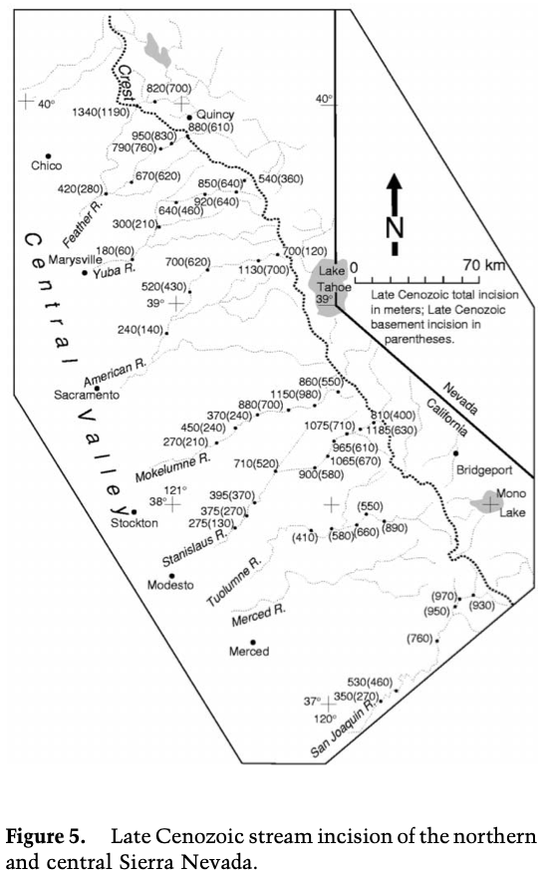
Key Observations
Stream stratigraphy:
Most Cenozoic stream incision occurred in the Late Cenozoic (onset ~3.5 Ma)
Eocene-Miocene incision rates significantly lower than Cenozoic
Valley floodplains have historically maintained their structure
Paleorelief:
Pre-Cenozoic relief increases southward
Eastern margin of Sierra is much steeper

Slide 6
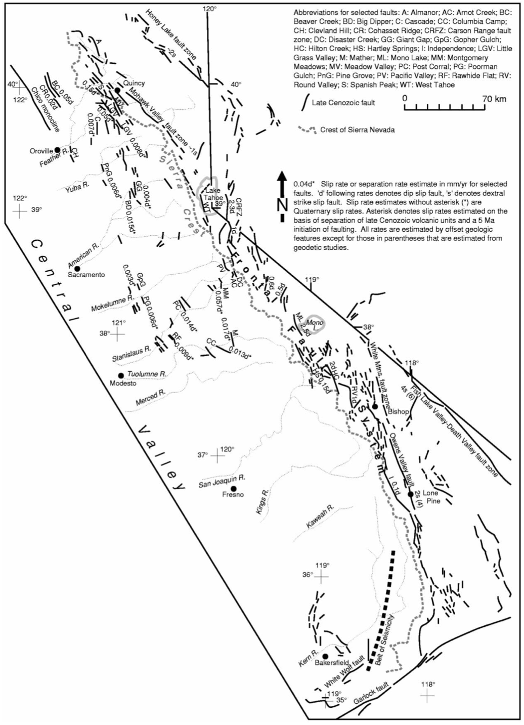
Key Observations
Faulting:
Eastern margin of Sierra is bound by right-lateral and oblique faults
Faults run through Cenozoic deposits and beheaded streams
Ages of escarpments suggests fault front has moved westward since 10 Ma
Belt of seismicity may be an incipient westward movement of the fault today (indicating it is still moving)

Slide 7
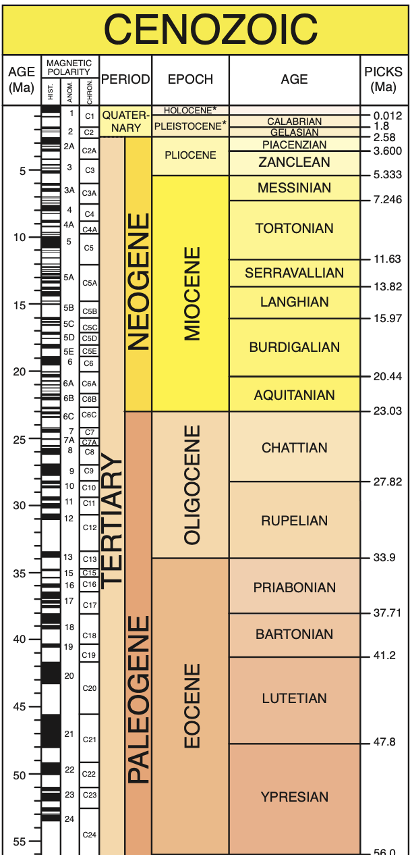
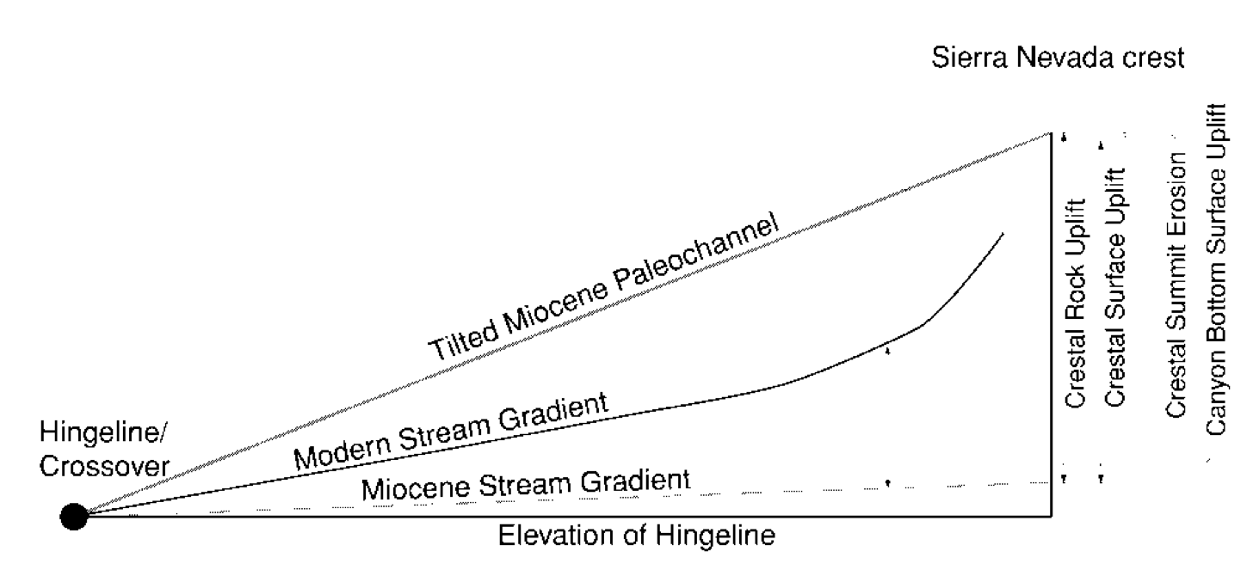
Analysis
Hinge: the range tilts about an axis
Hinge has stayed at the same elevation throughout the Cenozoic (unchanged floodplains)
Since modern gradients are higher than in the Miocene, the range must have tilted between those times

Slide 8
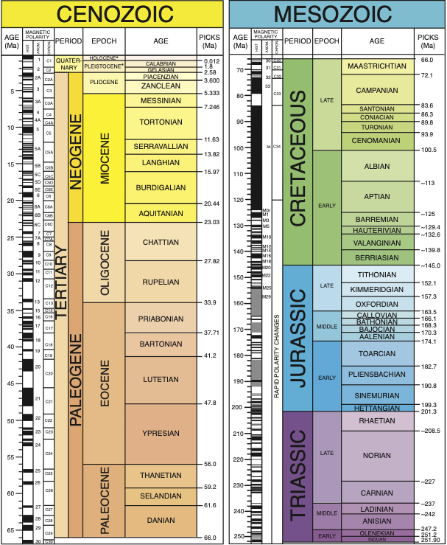
Analysis
Two periods of uplift?
Cretaceous-early Cenozoic paleorelief suggests an existing gradient in the Sierra
Increasing stream incision rates in late Cenozoic suggest a second period of uplift

Slide 9
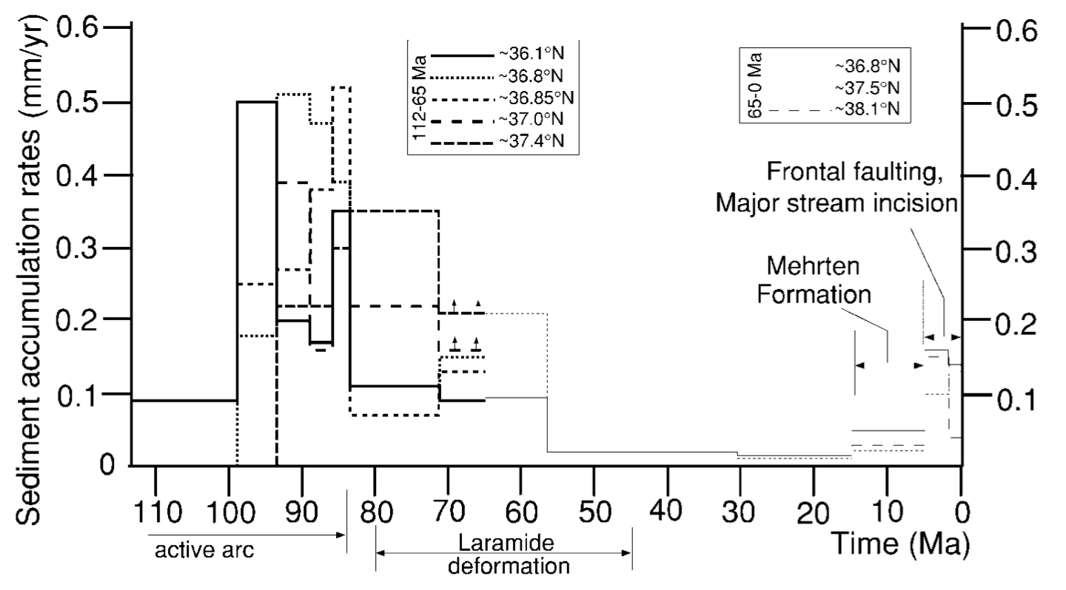
Analysis
Early Cenozoic uplift
Occurred during the end of Sierra plutonic intrusion (after ~85 Ma)
High erosion rates suggest significant uplift
Decrease in sediment deposit rates ~57 Ma suggest uplift ended around then

Slide 10
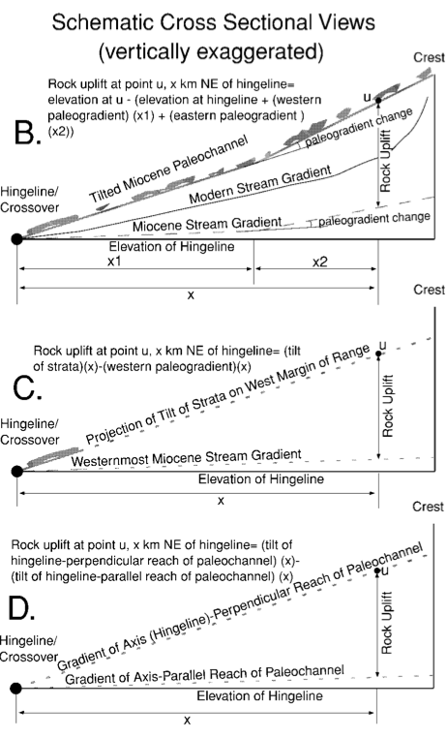
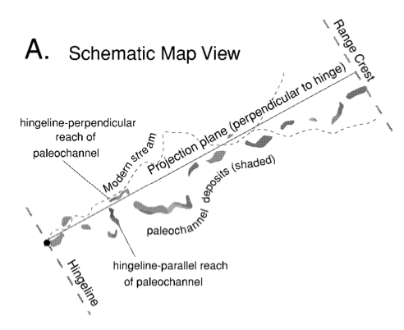
Analysis
Late Cenozoic uplift
Three methods to analyze:
Analyzing Cenozoic deposits spanning the whole range
Projecting westernmost tilted deposits
Comparing tilts of stream stretches that are parallel vs. perpendicular to hinge

Slide 11
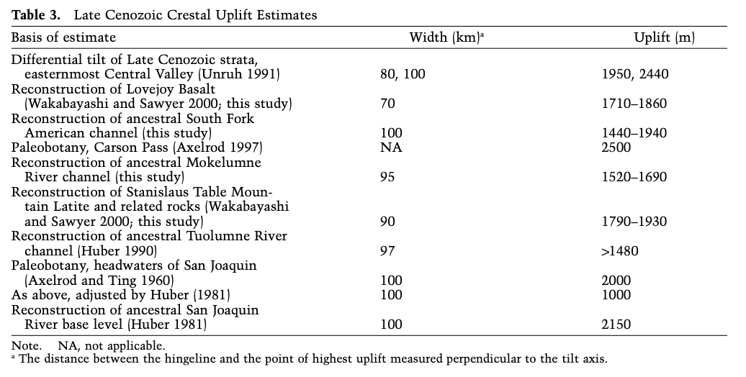
Interpretation
Late Cenozoic uplift ranges: ~1700-2000 m
Consistent along range strike

Slide 12
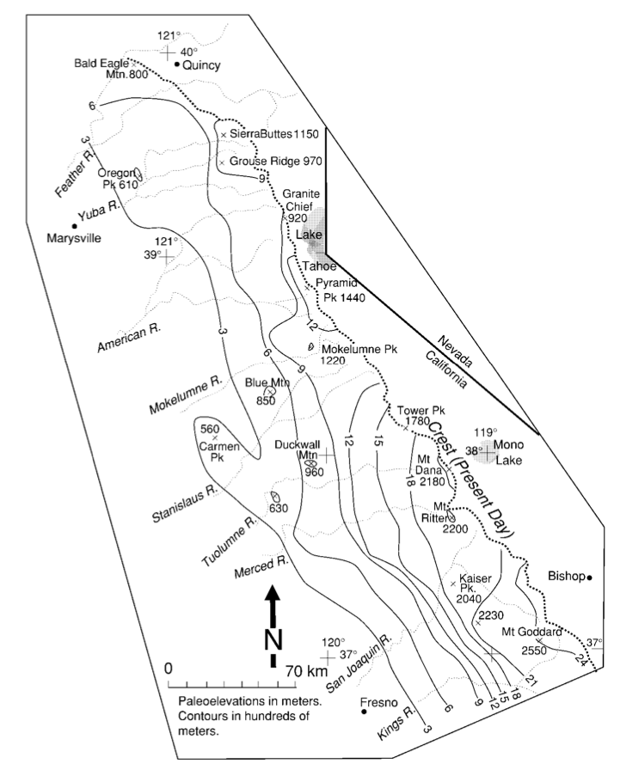
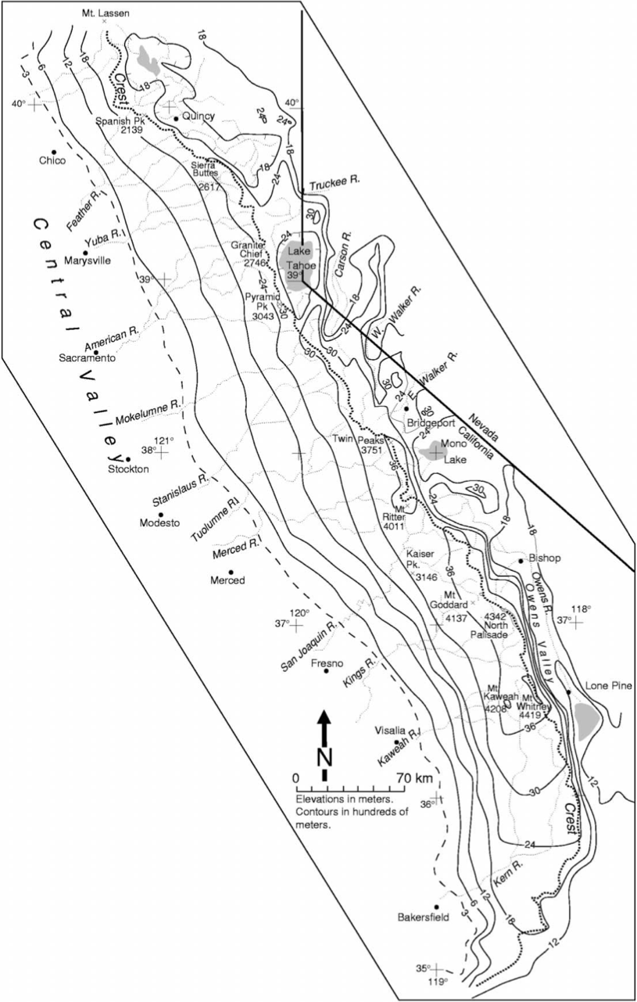
Interpretation
Sierra topography before Late Cenozoic uplift
vs. now

Slide 13
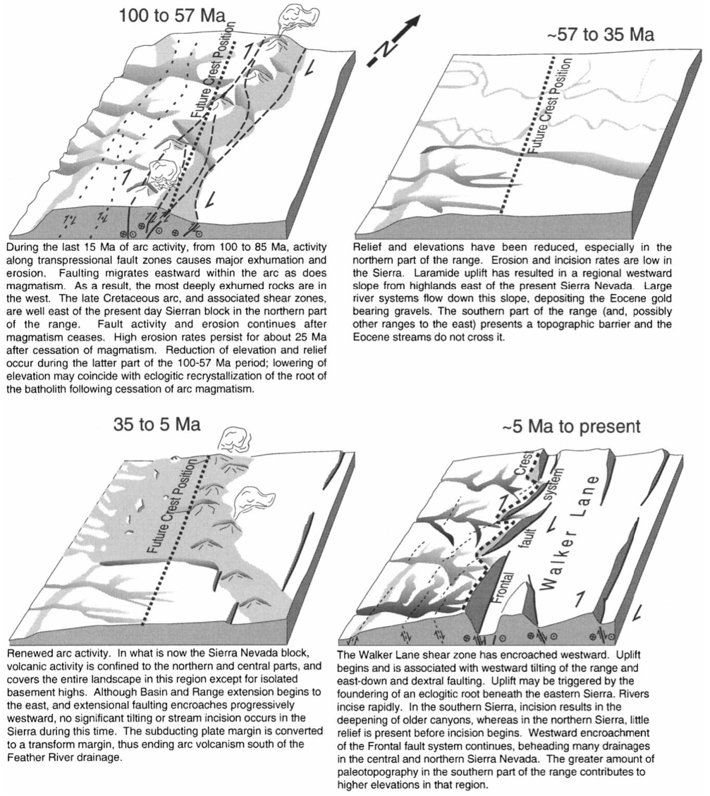
Interpretation
What caused the uplift?
Early Cenozoic: volcanism and faulting
Fault front migrates east along with volcanic formations
Greatest uplift on the western edge

Slide 14
Interpretation
What caused the uplift?
After first uplift:
Volcanism ceases, magmatic root crystallizes, pulling the range down
Normal faulting contributes to sinking
Erosion first contributes to elevation reduction, but slows down significantly

Slide 15
Interpretation
What caused the uplift?
Late Cenozoic: a change in tectonic environment
Change in relative motion of Pacific and North American plates around this time
Volcanism restarts, batholith root detaches, range becomes buoyant
Greatest uplift on the eastern edge (opposite to the hinge)

Slide 16
Summary
Known tectonics and volcanism suggest an environment prime for mountain formation and deformation
Streams and incisions expose volcanic strata and tell us about changes in the slope of the range
Past research provides age constraints and additional data
Sierra Nevada topography was formed by two periods of uplift: one from volcanism, and one from the detachment of a magmatic root

Slide 17
Abstract (don’t use this as a slide)
Sierra Nevada topography resulted from two periods of uplift and stream incision
Starting ~5 Ma: uplift, tilting, stream incision, faulting
1440-2150 m of Cenozoic uplift
Low erosion at summits – they can approximate surface uplift heights
Canyon bottoms have been uplifted
Deep paleo (Tertiary) channels suggest relief occurred before incision
Much higher elevations in South than North Sierra
Lesser Paleo-Eocene incisions suggest pre-uplift streams
Recrystallization of batholith root may have coincided with sinking
Late Cenozoic detachment may have triggered uplift again

